Slide 1




Why study Languages?
@wpbath
@bathambassador
#explorebathuni
/wpobath
+WPBath
Notes:
Why we are here today

Slide 2

In the news

Slide 3

English is not enough!
What other reasons for learning a language are there?
Here are some ideas from university and year 12/13 students:
It’s fun • you find out about other people and cultures • knowing a language makes you more employable • they lead you into other subjects • you make new friends • you learn about yourself and your own country • it gives you more confidence • great for holidays! • gives you communication skills…

Slide 4

Larry Lamb, actor in Gavin and Stacey
“As a working-class lad from North London, learning French opened up the world for me. My teacher spoke about this intriguing place over the sea called ‘abroad’. She triggered something in me about learning other languages and finding out about other people. You can’t put a price on that. If ordinary children are discouraged from learning languages, it weakens our society.”

Slide 5
It’s a multilingual world…
Did you know there are 6,912 known living languages in the world?
Only 11% of the world population speak English at all (about 840 million people out of 7.25 billion)
Less than 5% speak English as their first language.
Only 38% of Brits speak a foreign language (compared to 56% of Europeans)

Slide 6
It’s a multilingual Europe
11%
11%
6%
24%
16%
16%
16%

Slide 7

Why study languages
Do I want to start a successful business?
Do I want to go abroad?
Do I want to meet lots of interesting and exciting people?
Do I want to study a variety of topics and subjects at university?
Do I want to have a highly useful skill?
Do I want to have an excellent and well paid job?
Notes:
Here are some questions to ask yourself
I’m sure that you will have answered yes to most of these questions
We all want to have good jobs, successful carreers or businesss
And a way to move closer towards these goals is to study languages
We’re going to come back to these later on, but before that, let’s have a little quiz to get us warmed up.

Slide 8
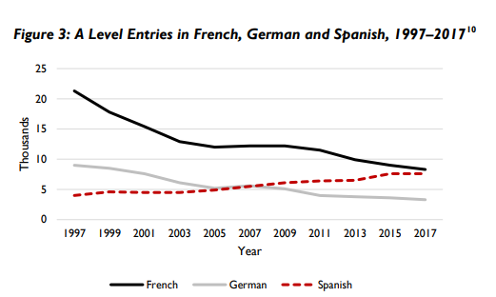
Stand out from the crowd!
Only a third (34%) of businesses rate as satisfactory the foreign language skills of school and college leavers entering the jobs market, with the major EU languages of French (51%), German (47%) and Spanish (45%) most commonly mentioned as in demand.
British Council, Language Trends 2018: Language Teaching in Primary and Secondary Schools in England, June 2018, p 9.

Slide 9
Employability: give yourself the edge
This is what a top employer said he is looking for in a new employee:
social skills
ability to work in a team
communication skills
problem-solving skills
confidence
experience
open mindedness
flexibility
Learning languages gives you these skills
Speaking another language makes you stand out from the crowd

Slide 10
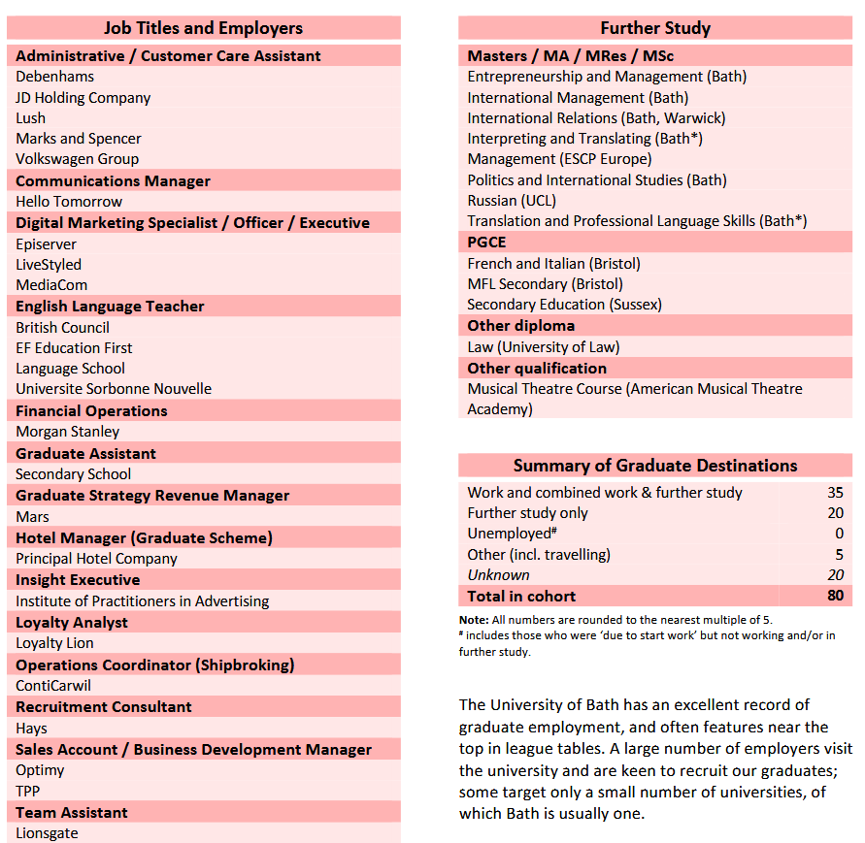
examples of jobs

Slide 11
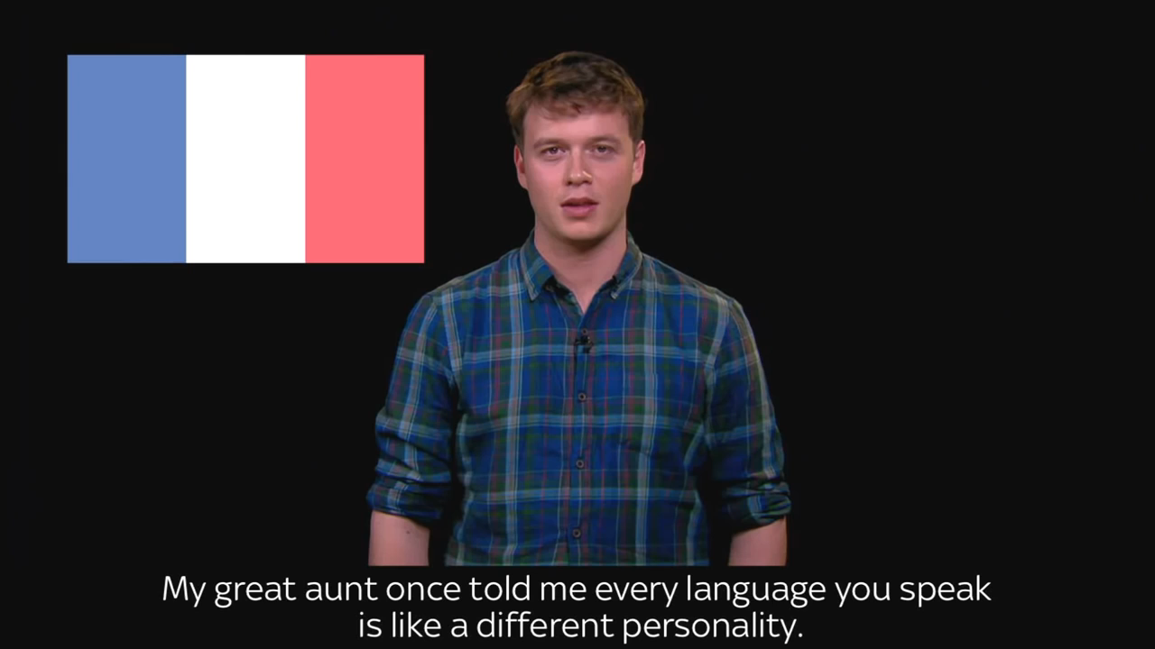
This could be you.

Slide 12

Language Degrees at Bath
Language and Politics
Master one European language and acquire the knowledge and analytical skills to understand the social, political and economic changes affecting Europe and the world.
French, German, Spanish,
Italian (ab initio)

Slide 13
Language Degrees at Bath
Modern Languages and European Studies
Achieve fluency in two languages and develop detailed knowledge and understanding of political and cultural issues
A combination of 2 (French, German, Spanish, Italian)

Slide 14
Foreign Languages Center
Undergraduate and postgraduate students may take a language course alongside their studies or as part of their degree.
All courses are free of charge.
There are a wide range of languages and levels available:
Arabic
Brazilian Portuguese
French
German
Italian
Japanese
Mandarin Chinese
Spanish

