Slide 1
Written communication
Effective Written Communication
Writing to impress
Write it right

Slide 2
Written communication
Group roles
Make final decisions
Read out to the group
Read out to the class
Write things down
Get up and move around when required
1 minute to assign roles

Slide 3
Written communication
Objectives:
To examine why we use different kinds of written communication
To explore which kinds of written communication are appropriate in different circumstances and why
To decide what kinds of written communication will be appropriate in our final presentations

Slide 4
Written Communication
EMAIL FLYER
LETTER ESSAY

Slide 5
Written Communication
What is appropriate written communication?
On your desks you have a number of cards that are related to written communication.
On the wall there are a number of situations when we might need written communication.
In your groups discuss and decide which of those on your desk would appropriately apply to the situations on the wall.

Slide 6
Written Communication
Using appropriate written communication
Read the short written task you have been given.
Discuss which of the list would be appropriate or not to your piece of writing and tick them appropriately.
Complete your task using as many of the appropriate elements as possible.

Slide 7
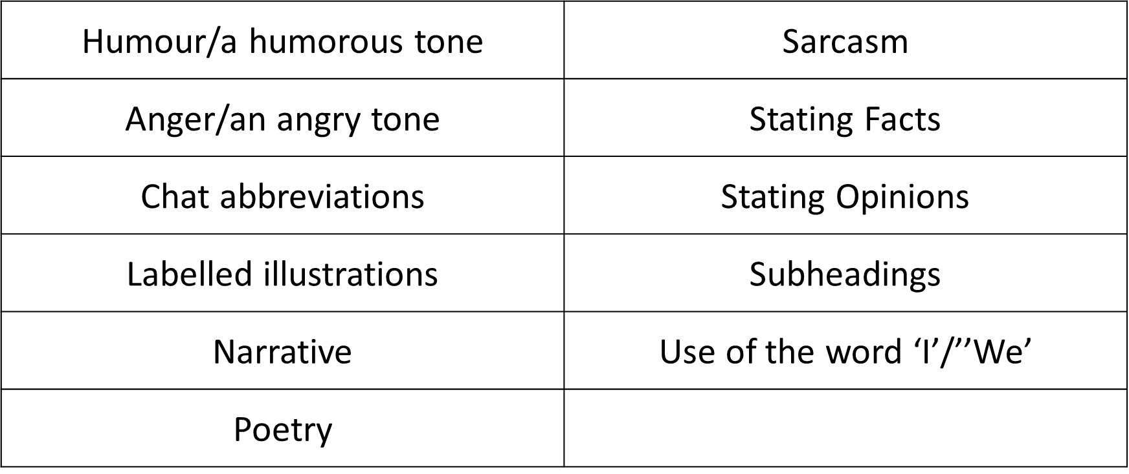
Written communication
What is going to be appropriate in our final presentations?

Slide 8
Written communication
Using all the ideas we have discussed today think of an appropriate title for today’s lesson.
Imagine it will be used in the lesson in future and also in promotional materials for this programme to be given out to staff and parents at other schools to persuade them to take part in the programme.

Slide 9
Written communication
Effective Written Communication
Writing to impress
Write it right

